Slide 1
Installation Guide
Smart Systems for Occupancy and Building Energy Control
Team: Dalaidis Hidalgo, Maria E. Presa Reyes Mentor: Ali Mostafavi, Leonardo Bobadilla

Slide 2
Perquisites
Software required to run this project:
1. Windows 7 – Windows 8.1, Mac OS, Ubuntu 14.04 LTS
2. Android Studio
Development environment applications:
1. Apache
2. MySQL
3. PHP5

Slide 3
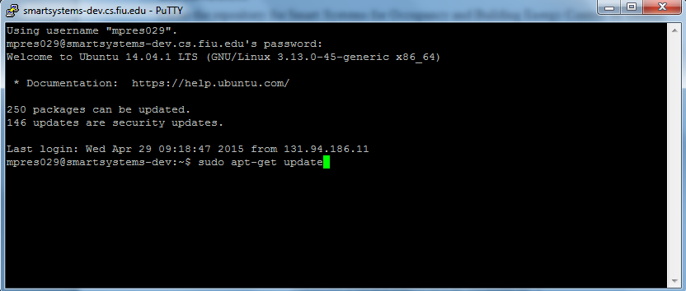
Setting up the database in the server

Slide 4
Install LAMP stack

Slide 5
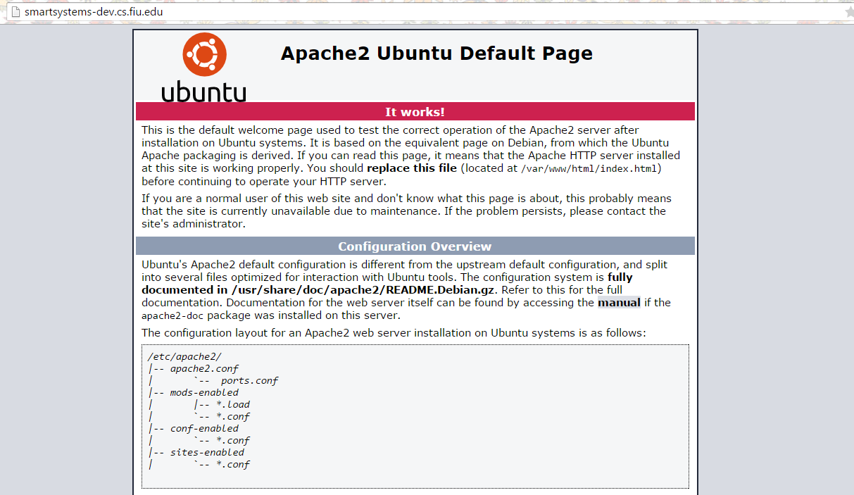
Notes:
This is the page you must see in your domain name

Slide 6
Run The Following Commands to Install Phpmyadmin

Slide 7
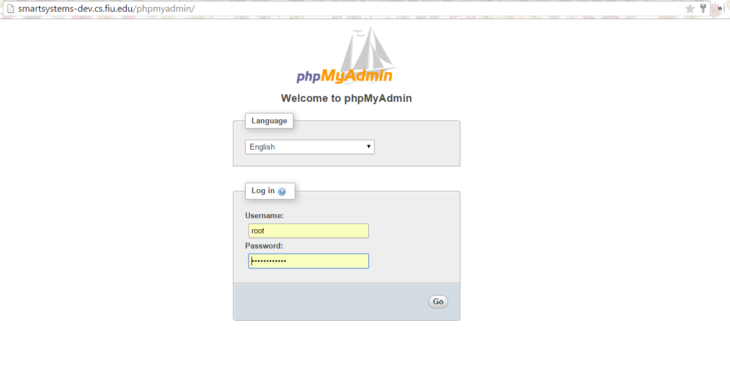

Slide 8
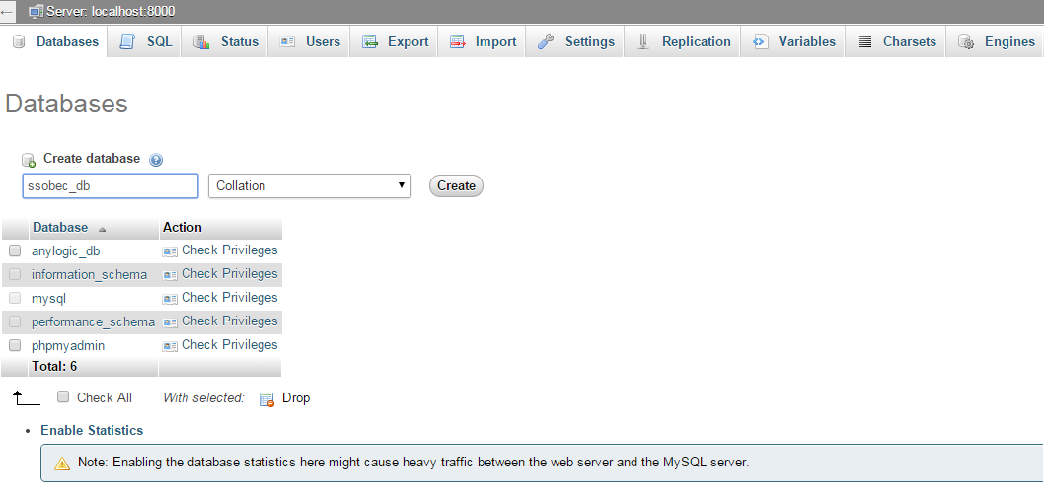

Slide 9
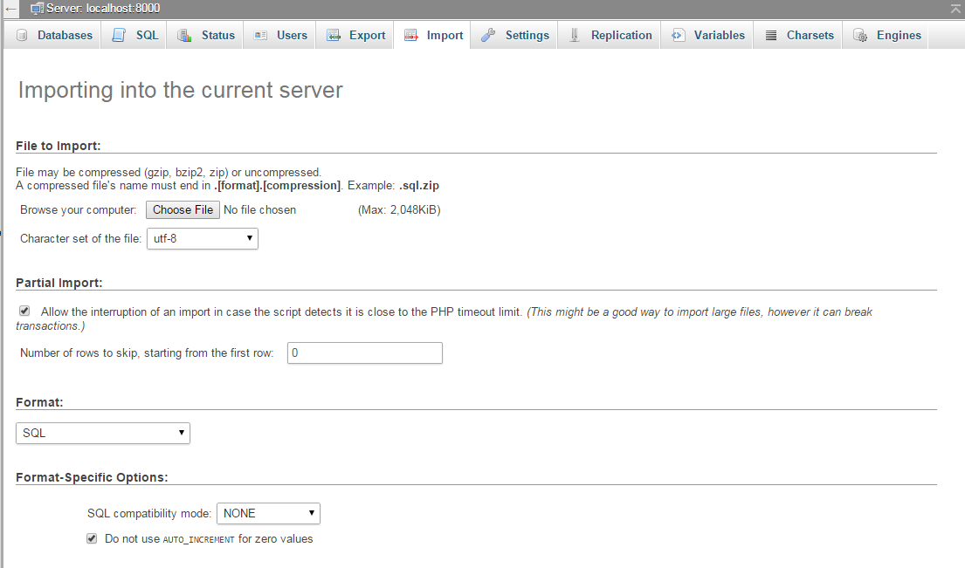

Slide 10
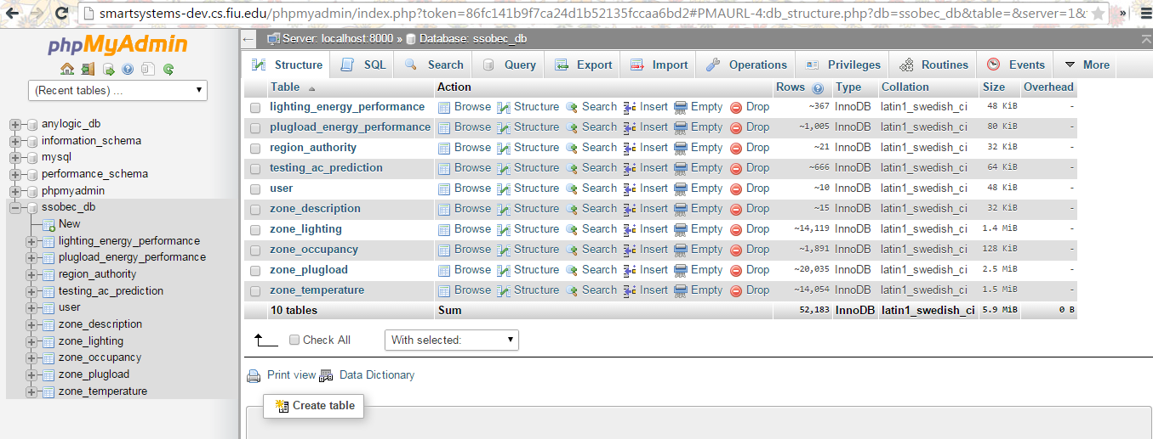

Slide 11
Install the Application

Slide 12
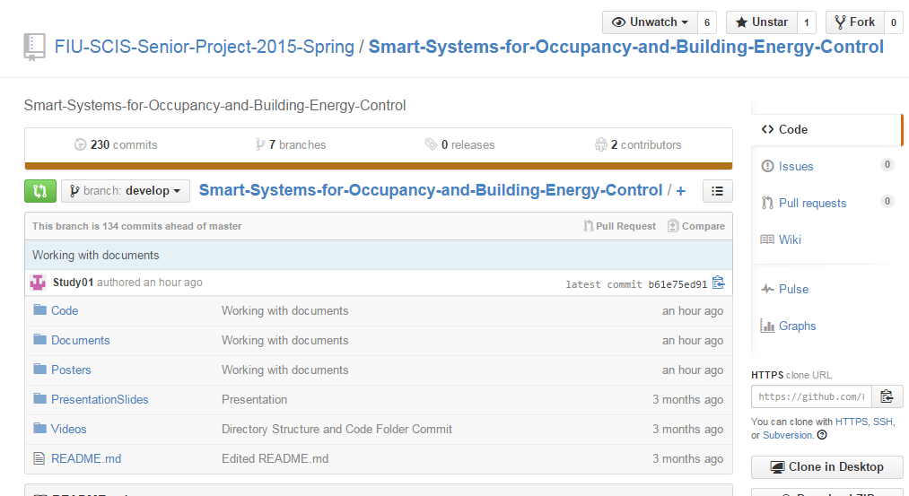
Notes:
In the video description you will find a link to the repository for SSOBEC

Slide 13
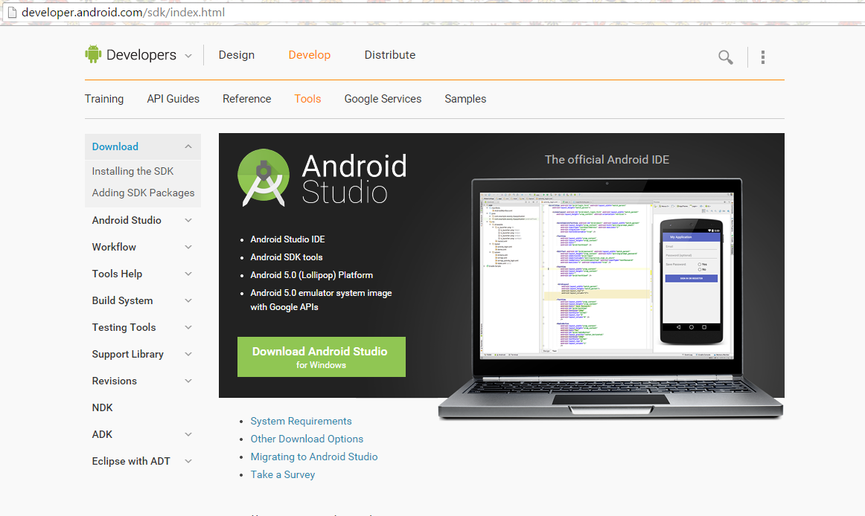

Slide 14
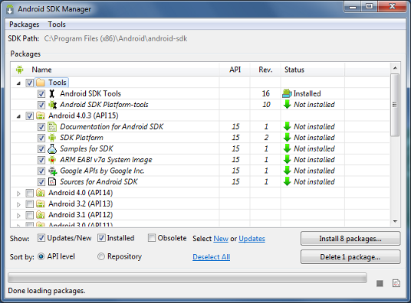

Slide 15
